Slide 1
Knuth Morris Pratt’s (KMP) String Matching Algorithm
Presented By:
1. Tasneem Rahman Adiba (011191259)
2. Debopom Sutradhar (011201046)
3. Mahbub Hasan (011181134)
4. Yeasir Arafat (011201035)
5. Sami Nayeem (011193020)

Slide 2
Table of contents
01
02
03
04
05
Concept/Motivation
Simulation
Why should we use this algorithm?
How this algorithm works?
Pseudocode
Code
Time Complexity
What can be the procedure?
The applied C++ code for this algorithm
The runtime analysis

Slide 3
Concept
The problem of finding occurrence(s) of a pattern string within another string or body of text. There are many different algorithms for efficient searching. Also known as exact string matching, string searching, text searching.
String Matching
Naive Approach
KMP’s Algorithm

Slide 4
Naive Approach
The naive algorithm finds all the valid shifts using a loop that checks the condition P[ 1…….m ] = T[ s + 1……s + m ] for each of the n-m+1 possible values of s

Slide 5
KMP’s Algorithm
Knuth Morris Pratt proposed the first time complexity algorithm for the string matching problem
The time complexity of KMP’s algorithm is O(m+n). Meanwhile the time complexity naive approach is O(m*n)

Slide 6
KMP’s Algorithm
The time complexity of KMP’s algorithm is achieved by avoiding comparisons with elements of ‘S’ that have previously been involved in comparison with some element of the pattern ‘p’ to be matched.
i.e. , backtracking on the string ‘S’ never occurs

Slide 7
Functions of KMP’s Algorithm
There are 2 major functions of KMP’s algorithm which are-
The prefix function, PI
The KMP Matcher

Slide 8
The prefix function
The prefix function or PI function for a pattern encapsulates knowledge about how the pattern matches against shifts of itself. This information can be used to avoid useless shifts of the pattern ‘p’. In other words this enables avoiding backtracking on the string ‘S’.

Slide 9
The KMP Matcher
Finds the occurrence of 'p' in 'S' and returns the number of shifts of 'p' after which the occurrence is detected, using string 'S', pattern 'p', and prefix function 'PI' as inputs.

Slide 10
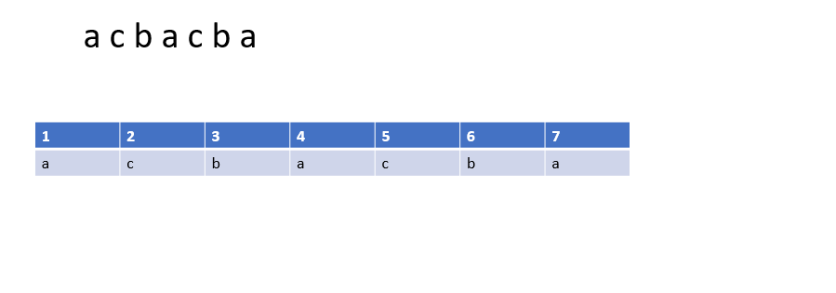
PI Table or LPS

Slide 11
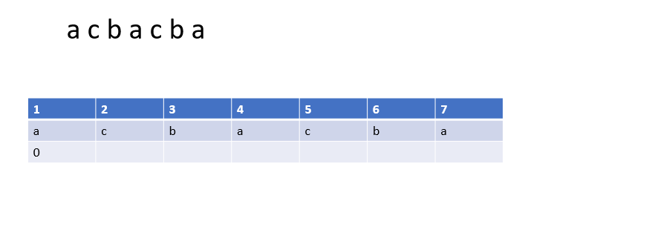
PI Table or LPS

Slide 12
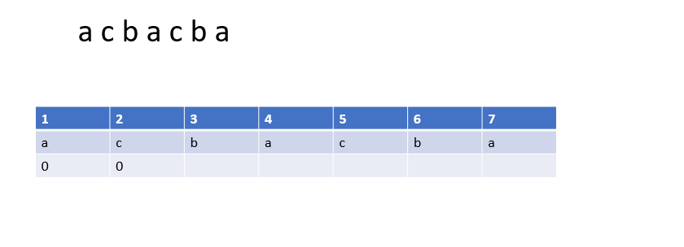
PI Table or LPS

Slide 13
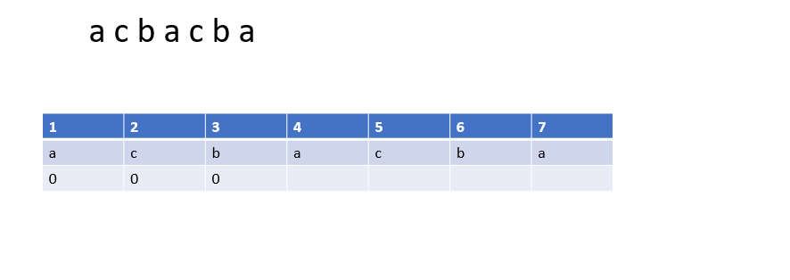
PI Table or LPS

Slide 14

PI Table or LPS

Slide 15
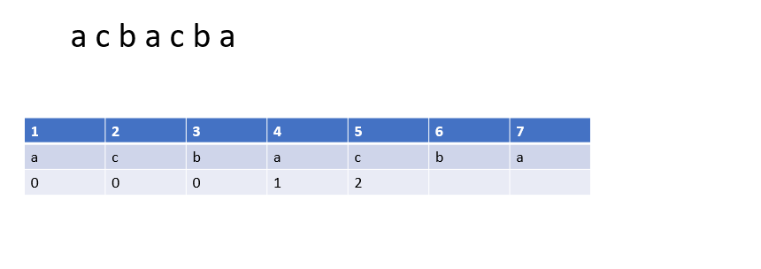
PI Table or LPS

Slide 16
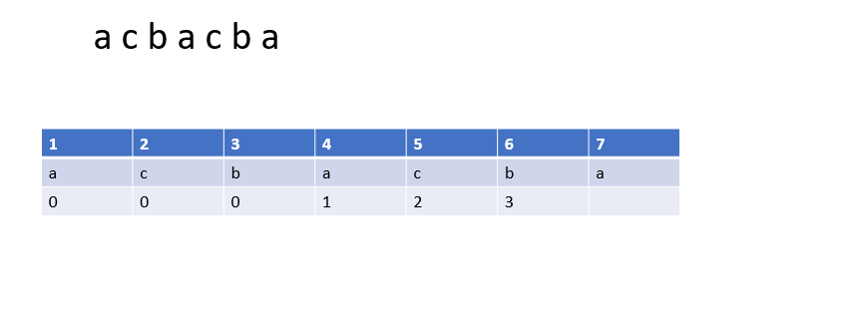
PI Table or LPS

Slide 17
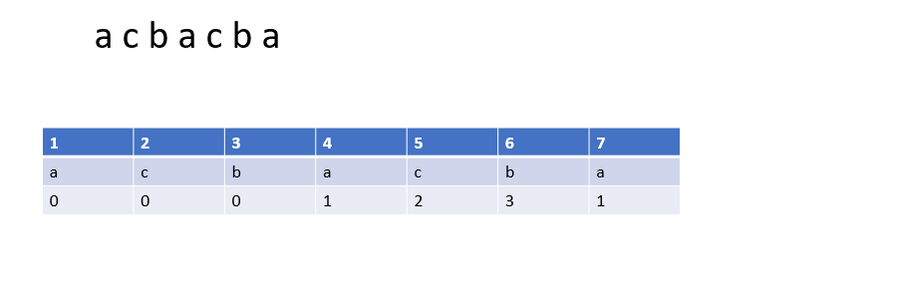
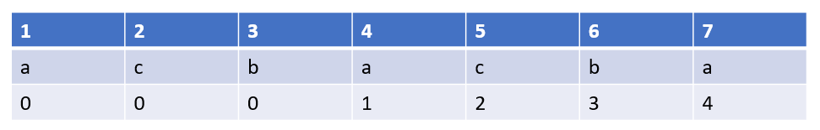
PI Table or LPS

Slide 18
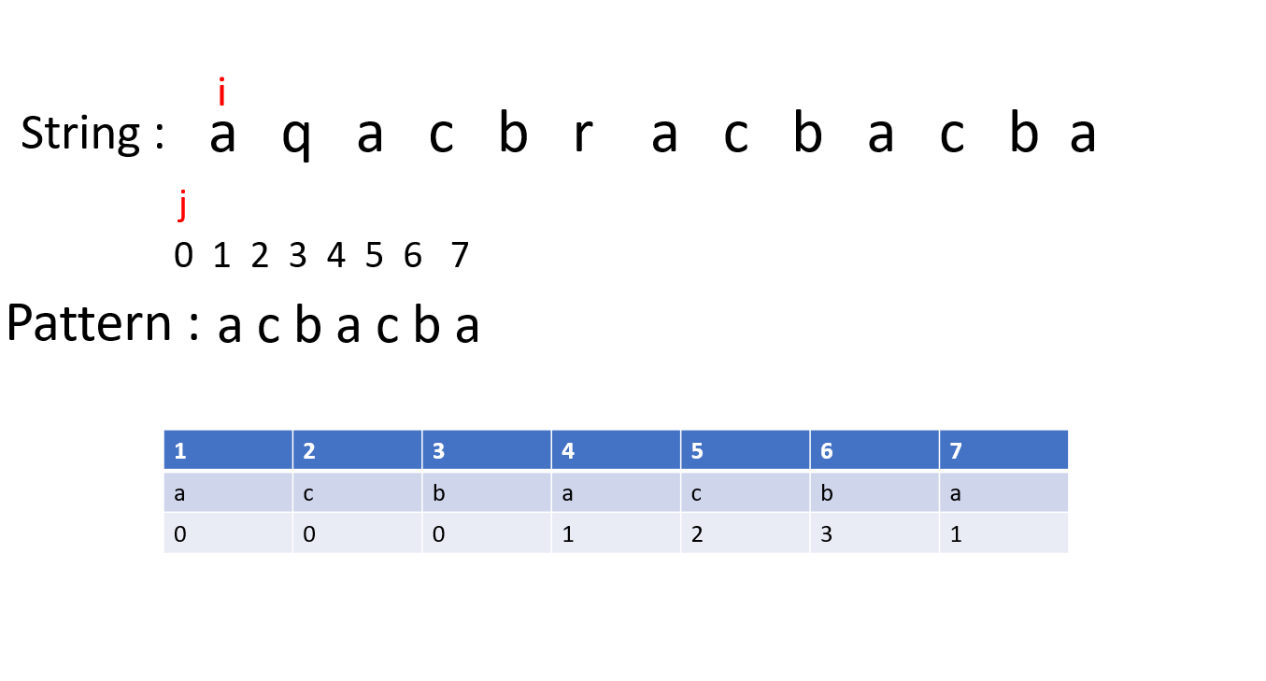
Simulation

Slide 19
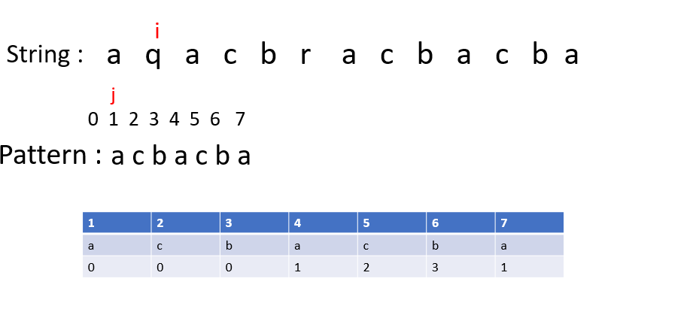
Simulation

Slide 20
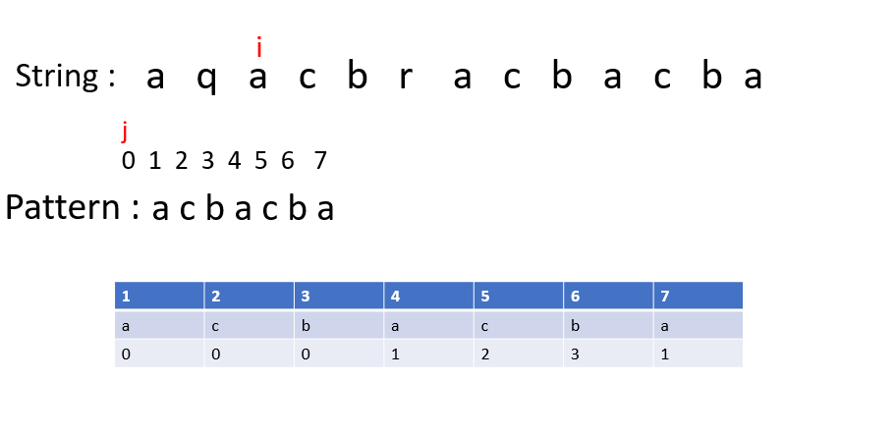
Simulation

Slide 21
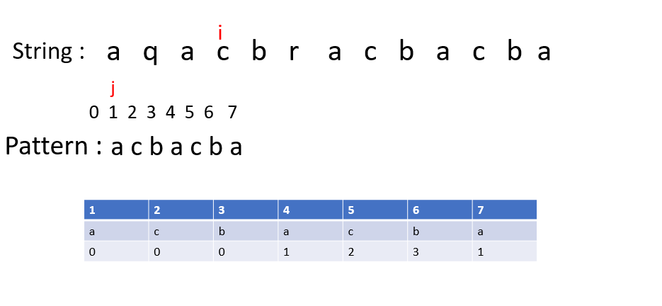
Simulation

Slide 22
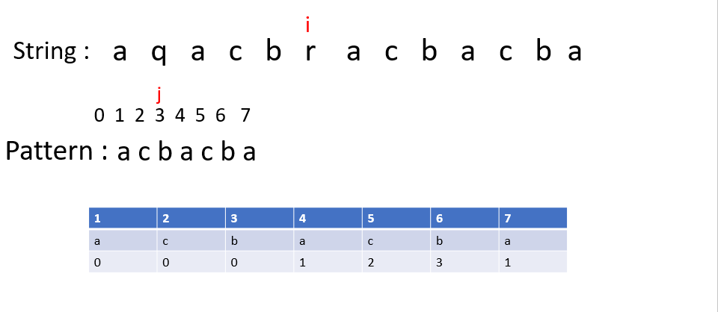
Simulation

Slide 23
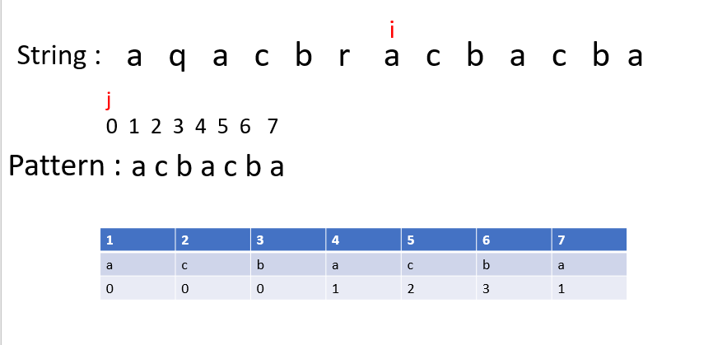
Simulation

Slide 24
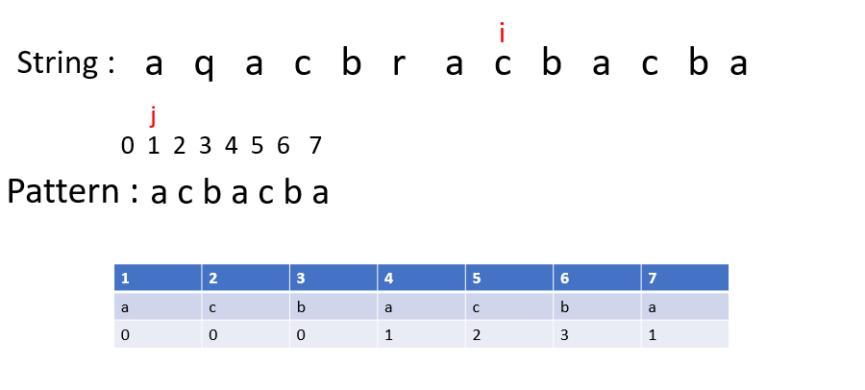
Simulation

Slide 25
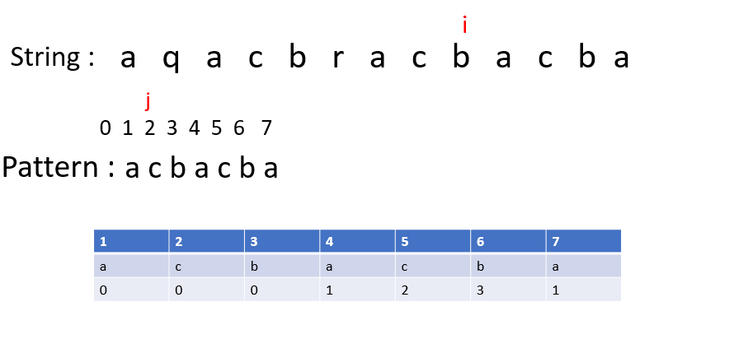
Simulation

Slide 26
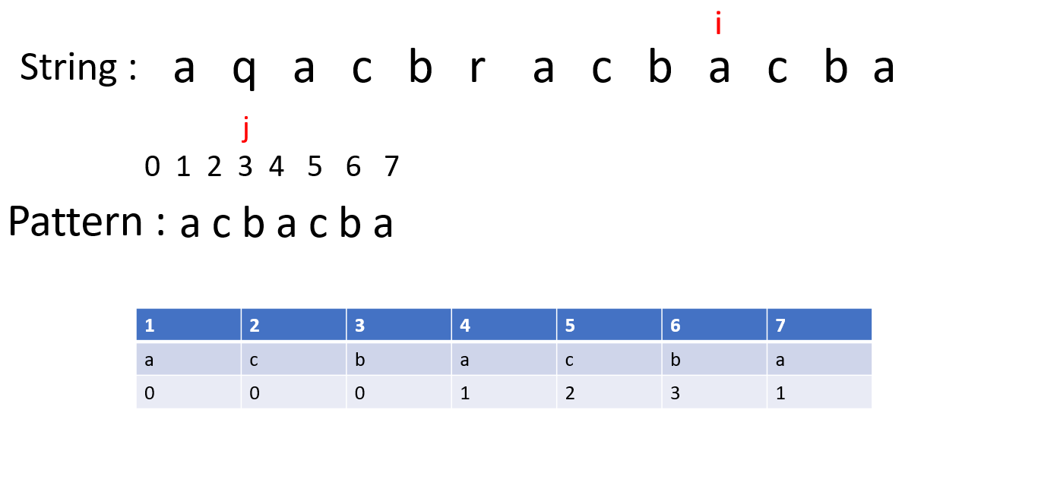
Simulation

Slide 27
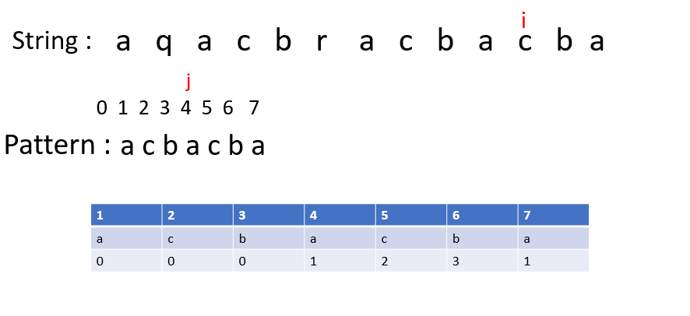
Simulation

Slide 28
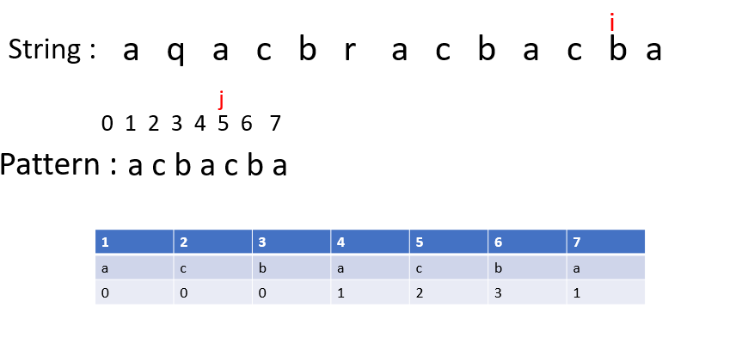
Simulation

Slide 29
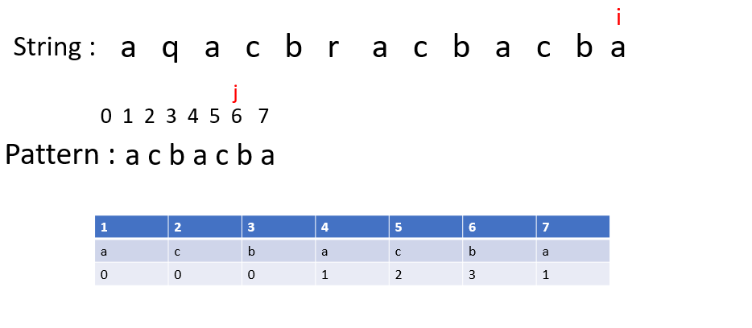
Simulation

Slide 30
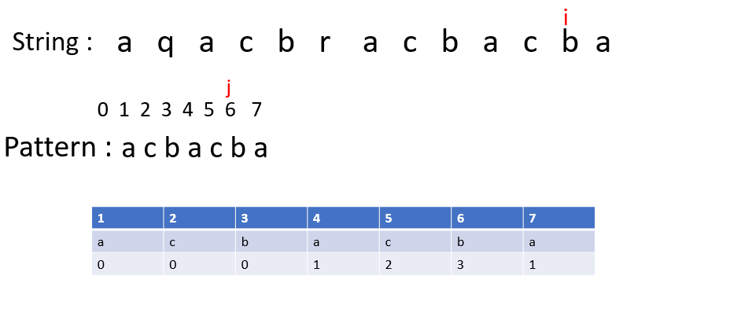
Simulation

Slide 31
Pseudocode (Prefix Function)
function calc_ps(pattern,p_len)
lps[p_len];
lps[0]=0;
length = 0;
for i=1 to p_len
if pattern[i] == pattern[length]
lps[i] = length + 1;
length++; i++;
else
if length != 0
length = lps[length - 1];
else
lps[i] = length;
i++;
return lps;
End

Slide 32
Pseudocode (KMP Matcher)
function kmp (str, pattern, p_len, s_len, & foundAt)
lps[] = calc_ps(pattern,p_len,s_len);
i = 0, j = 0;
while (i < s_len)
if str[i] == pattern[j]
i++; j++;
else
if (j != 0) j = lps[j - 1];
else i++;
if j == p_len
foundAt = i-p_len;
j = lps[j-1];
return true;
return false;
End

Slide 33
Code for KMP
int main() {
string str="aqacbracbacba";
string pattern="acbacba";
int p_len = pattern.length();
int s_len = str.length();
int foundAt;
bool isFound = kmp(str, pattern,p_len,s_len,foundAt);
if(isFound){
cout<<"Found at index "<<foundAt<<" to "<<foundAt+p_len-1;
}
else{
cout<<"Not Found";
}
return 0;
}

Slide 34
Code for KMP
bool kmp (string str, string pattern,int p_len,int s_len,int& foundAt) {
vector<int> lps = calc_ps(pattern,p_len);
int i = 0, j = 0;
while (i < s_len) {
if (str[i] == pattern[j]){
i++; j++;
}
else {
if (j != 0)
j = lps[j - 1];
else
i++;
}
if (j == p_len) {
foundAt = i-p_len;
j = lps[j-1];
return true;
}
}
return false;
}
#include <bits/stdc++.h>
using namespace std;
vector<int> calc_ps(string pattern,int p_len) {
vector<int> lps(p_len);
int length = 0;
int i = 1;
while (i < p_len) {
if (pattern[i] == pattern[length]){
lps[i] = length + 1;
length++; i++;
}
else {
if (length != 0)
length = lps[length - 1];
else{
lps[i] = length;
i++;
}
}
}
return lps;
}

Slide 35
Pattern: ACBAC
length = 0 i=0
pat
A | C | B | A | C
0
lps
0 1 2 3 4

Slide 36
Pattern: ACBAC
length = 0 i=1
pat
A | C | B | A | C
0 | 0
lps
0 1 2 3 4

Slide 37
Pattern: ACBAC
length = 0 i=2
pat
A | C | B | A | C
0 | 0 | 0
lps
0 1 2 3 4

Slide 38
Pattern: ACBAC
length = 0 1 i=3
pat
A | C | B | A | C
0 | 0 | 0 | 1
lps
0 1 2 3 4

Slide 39
Pattern: ACBAC
length = 1 2 i=4
pat
A | C | B | A | C
0 | 0 | 0 | 1 | 2
lps
0 1 2 3 4

Slide 40
String: ACBAACBACA
Pattern: ACBAC
i
str
A | C | B | A | A | C | B | A | C | A
0 1 2 3 4 5 6 7 8 9
j
pat
A | C | B | A | C
0 | 0 | 0 | 1 | 2
lps
0 1 2 3 4

Slide 41
String: ACBAACBACA
Pattern: ACBAC
i
str
A | C | B | A | A | C | B | A | C | A
0 1 2 3 4 5 6 7 8 9
j
pat
A | C | B | A | C
0 | 0 | 0 | 1 | 2
lps
0 1 2 3 4

Slide 42
String: ACBAACBACA
Pattern: ACBAC
i
str
A | C | B | A | A | C | B | A | C | A
0 1 2 3 4 5 6 7 8 9
j
pat
A | C | B | A | C
0 | 0 | 0 | 1 | 2
lps
0 1 2 3 4

Slide 43
String: ACBAACBACA
Pattern: ACBAC
i
str
A | C | B | A | A | C | B | A | C | A
0 1 2 3 4 5 6 7 8 9
j
pat
A | C | B | A | C
0 | 0 | 0 | 1 | 2
lps
0 1 2 3 4

Slide 44
String: ACBAACBACA
Pattern: ACBAC
i
str
A | C | B | A | A | C | B | A | C | A
0 1 2 3 4 5 6 7 8 9
j
pat
A | C | B | A | C
0 | 0 | 0 | 1 | 2
lps
0 1 2 3 4

Slide 45
String: ACBAACBACA
Pattern: ACBAC
i
str
A | C | B | A | A | C | B | A | C | A
0 1 2 3 4 5 6 7 8 9
j
pat
A | C | B | A | C
0 | 0 | 0 | 1 | 2
lps
0 1 2 3 4

Slide 46
String: ACBAACBACA
Pattern: ACBAC
i
str
A | C | B | A | A | C | B | A | C | A
0 1 2 3 4 5 6 7 8 9
j
pat
A | C | B | A | C
0 | 0 | 0 | 1 | 2
lps
0 1 2 3 4

Slide 47
String: ACBAACBACA
Pattern: ACBAC
i
str
A | C | B | A | A | C | B | A | C | A
0 1 2 3 4 5 6 7 8 9
j
pat
A | C | B | A | C
0 | 0 | 0 | 1 | 2
lps
0 1 2 3 4

Slide 48
String: ACBAACBACA
Pattern: ACBAC
i
str
A | C | B | A | A | C | B | A | C | A
0 1 2 3 4 5 6 7 8 9
j
pat
A | C | B | A | C
0 | 0 | 0 | 1 | 2
lps
0 1 2 3 4

Slide 49
String: ACBAACBACA
Pattern: ACBAC
i
str
A | C | B | A | A | C | B | A | C | A
0 1 2 3 4 5 6 7 8 9
j
pat
A | C | B | A | C
0 | 0 | 0 | 1 | 2
lps
0 1 2 3 4

Slide 50
String: ACBAACBACA
Pattern: ACBAC
i
str
A | C | B | A | A | C | B | A | C | A
0 1 2 3 4 5 6 7 8 9
j
pat
A | C | B | A | C
0 | 0 | 0 | 1 | 2
lps
0 1 2 3 4

Slide 51
Time Complexity
vector<int> calc_ps(string pattern,int m) {
vector<int> lps(p_len);
int length = 0;
int i = 1;
while (i < m) {
if (pattern[i] == pattern[length]){
lps[i] = length + 1;
length++; i++;
}
else {
if (length != 0)
length = lps[length - 1];
else{
lps[i] = length;
i++;
}
}
}
return lps;
}
Running Time
}
O(1)
}
O(m)
Overall : O(m)

Slide 52
Time Complexity
Running Time
bool kmp (string str, string pattern,int m,int n,int& foundAt) {
vector<int> lps = calc_ps(pattern,m);
int i = 0, j = 0;
while (i < n) {
if (str[i] == pattern[j]){
i++; j++;
}
else {
if (j != 0)
j = lps[j - 1];
else
i++;
}
if (j == m) {
foundAt = i-m;
j = lps[j-1];
return true;
}
}
return false;
}
O(m)
}
O(n)
Overall : O(m+n)

Slide 53
Time Complexity
So, as can be seen from the previous runtime analysis, the runtime analysis of KMP's Algorithm is O(m+n) which is far better than the runtime of brute force algorithm O(m*n)

Slide 54
Thank You

